Slide 1


Customer SOR- HDC
Coordinated HDC | By coordinating the energy recovery force and the braking system, the vehicle automatically controls downhill speed, improving energy recovery efficiency and driving safety while reducing driving difficulty.
VMC
command
Braking
HMI(HDC)
command
state
state
command
VCU
Inverter
state

Slide 2
HDC function interface proposal in VMC
 | Torque interface solution with external ECU | Consideration
1 | 1×total brake torque 4×total brake torque /slip limit 2× regen torque 1× AWD distribution factor | 1. Braking will consider the brake torque distribution between 4 wheels 2. VCU will consider the regen torque distribution between e-motors 3. Regen torque will ramp out when ABS active 4. How to ensure the acceleration consistence when handling the ABS on/off in vmc?
2 | 4× wheel brake torque (4x wheel pressure ) 1× regen torque | Prefer to the wheel pressure other than wheel torque to avoid the valve on/off. Should VMC consider the load transfer when distribution the braking torque, which will lead to the actuator on/off action?
3 | 4× wheel brake torque (4x wheel pressure ) 2× axle regen torque | 1. Axle regen torque could be calculated by VMC considering load transfer
4 | 1× deceleration (vehicle level) | Braking will distribute the regen torque and hydraulic torque Braking will consider all situations such as: load transfer/ABS intervention
√

Slide 3

HDC system architecture design
Main control flow for HDC in braking:
Zone VMC
4× wheel brake torque
HDC status
Braking
HDC Request
Target speed?
HMI(HDC)
HDC
Torque arbitration
ABS
Total brake capacity/ Brake disk normal
ABS status
Regen Enable flag???
Brake Request
（EDTR）Engine Drag Torque Regulation
HDC status
EDTR flag
EDTR Torque Limit
Torque act front/rear
1× regen torque
1× front/rear distribution factor
HDC status
VCU
Inverter
Torque Coordination
Torque Stability Intervention front
Drive torque request
Torque Stability Intervention rear
Axle regen torque capacity
Torque act front/rear
CDC

Slide 4
HDC system architecture design
When HDC active:
Braking unit should execute the friction torque
Propulsion unit should execute the regen torque
During ABS/EDTR event, braking unit should send out the torque intervention flag and torque limitation, HDC and VCU shall both follow the torque limiation

Slide 5
Use case #1 – HDC Regen active during ABS, EDTR active
ABS active
EDTR active
Time(s)
Regen request
Sys Decel torque demand
EDTR request
If EDTR is active, then RB shall not reduce
torque below EDTR
Torque (Nm)
Pressure (bar)
friction torque request
Pressure req
If ABS flag active, the friction torque request should freeze
Time(s)

Slide 6
Use Case #2 – HDC Regen active during ABS, EDTR Active, EDTR exits mid event
ABS active
EDTR active
EDTR exit
Time(s)
Regen request
Sys Decel torque demand
EDTR request
If EDTR flag active, then regen torque shall not follow EDTR nor increase its torque request
Torque (Nm)
Pressure (bar)
friction torque request
pressure Req
If ABS flag active, the friction torque request should freeze
Time(s)

Slide 7
EHBi 只对应双电机车型：
PrDrvShftIncTorqRqst_FD | Primary Drive Shaft Increase Torque Request | BrkDriveControl.IncreaseTqRqstFrontAxle
PrDrvShftIncTorqRqstVal_FD | Primary Drive Shaft Increase Torque Request Value | BrkDriveControl.IncreaseTqRqstValFrontAxle
ThScdDrvShftIncTorqRqst_FD | The Second Drive Shaft Increase Torque Request | BrkDriveControl.IncreaseTqRqstRearAxle
ThScdDrvShftIncTorqRqstVal_FD | The Second Drive Shaft Increase Torque Request Value | BrkDriveControl.IncreaseTqRqstValRearAxle
EMB 只对应4电机车型：
FrntLeDrvMotorIncTorqRqst | Front left motor Increase Torque Request | BrkDriveControl.IncreaseTqRqstFrontLeft
FrntRiDrvMotorncTorqRqst | Front Right motor Increase Torque Request | BrkDriveControl.IncreaseTqRqstFrontRight
ReLeDrMotorIncTorqRqst | Rear left motor Increase Torque Request | BrkDriveControl.IncreaseTqRqstRearLeft
ReRiDrvMotorIncTorqRqst | Rear Right motor Increase Torque Request | BrkDriveControl.IncreaseTqRqstRearRight
FrntLeDrvMotorIncTorqRqstVal | Front left motor Increase Torque Request Value | BrkDriveControl.IncreaseTqRqstValFrontLeft
FrntRiDrvMotorncTorqRqstVal | Front Right motor Increase Torque Request Value | BrkDriveControl.IncreaseTqRqstValFrontRight
ReLeDrMotorIncTorqRqstVal | Rear left motor Increase Torque Request Value | BrkDriveControl.IncreaseTqRqstValRearLeft
ReRiDrvMotorIncTorqRqstVal | Rear Right motor Increase Torque Request Value | BrkDriveControl.IncreaseTqRqstValRearRight

Slide 8
Use Case #3 – HDC Regen active during ABS, ABS inhibits regen
ABS active
ABS prohibits regen
Time(s)
Regen request
Sys Decel torque demand
Once regen is inhibited, it shall no longer
be allowed until HDC state transfer to Inactive
Torque (Nm)
Pressure (bar)
friction torque request
pressure Req
If ABS flag active, the friction torque request should freeze
Time(s)

Slide 9
Use Case #4 – HDC Regen active during ABS, ABS inhibits regen
ABS active
ABS enable regen
Time(s)
Regen request
Sys Decel torque demand
If regen is enabled by braking, and ABS active, regen torque should freeze its request
Torque (Nm)
Pressure (bar)
friction torque request
pressure Req
If ABS flag active, the friction torque request should freeze
Time(s)

Slide 10
HDC function architecture design
A proposal of HDC in VMC:
AWDBD in negative area torque
Infobase potential calculation longitudinal
?
?
ARB
(Torque distribution)
Target Calculation
4×wheel brake torque+sliplimit
HDC
(Calc sum decel torque)
1× sum decel torque
1× brake torque
or
1× brake torque
1× regen torque
1× regen torque
front regen torque
rear regen torque
Regen torque state(HDC state)
Brake state
Motor Capacity

Slide 11
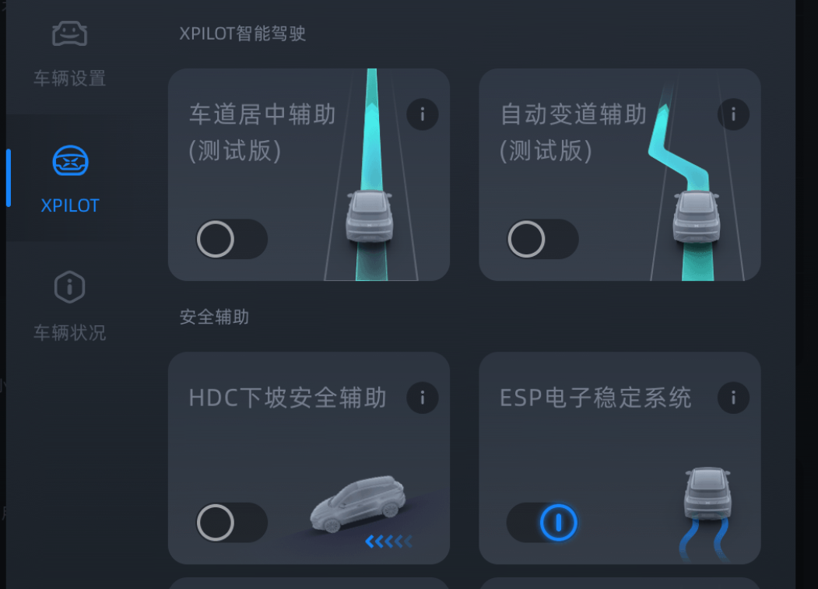
Market HDC function 2.XiaoPeng
HDC 是一种巡航功能，它能帮助驾驶员匀速下坡，缓解下坡时一直踩踏制动踏板的脚步疲劳。
车辆上电后，HDC默认为关闭状态.进入控制界面，点击“辅助驾驶”按钮，进入辅助驾驶界面，点击“HDC下坡安全辅助”开关开启或关闭。
●HDC能在≤50%的坡道上工作。
●开启 HDC 的条件：车速<40km/h；40km/h<车速<60km/h无法开启，车速>60km/h自动关闭，制动盘温度正常；ESP 系统正常

Slide 12
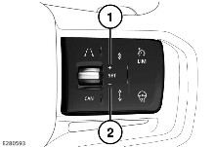
Market HDC function 3.Land Rover
当下坡行驶时，陡坡缓降控制系统 (HDC) 将车辆速度限制至设定限值。
在下坡期间，如果发动机制动不足以控制车速，HDC 会自动地操纵制动器，以降低车速，并维持一个对应于选中的档域和加速器踏板位置的速度。
要调节车辆的下坡速率：
按下并松开 SET+（设置+）按钮，以 1 公里/小时（0.6 英里/小时）的增量提高车辆速度。 按住 SET+（设定+）按钮以大幅提升车速，最高可至最大允许速度。
按下并松开 - 按钮可以 1 公里/小时（0.6 英里/小时）的增量降低车辆速度。 按住 - 按钮以大幅降低车速，最低降至最小允许速度。
仪表盘显示当前设定的速度以及可用的设定速度范围

Slide 13
HDC/CC function in Braking
Main control flow for HDC in braking:
Cc:
Launch Assist/HDC
Only contain brake torque, no negative engine torque
Launch assist and HDC are included in CC
HDC will keep on when ABS active
SpdReq
Lc:
lc_spd_control
lc_engine_handler
(only positive torque)
EngTorqReq_s16
LcEngReqActive_bn
Decel_Req
Decel_Req
lc_control
lc_force_to_press
LcPressReq_s16[Whl_u8]
Force_Req

